Slide 1
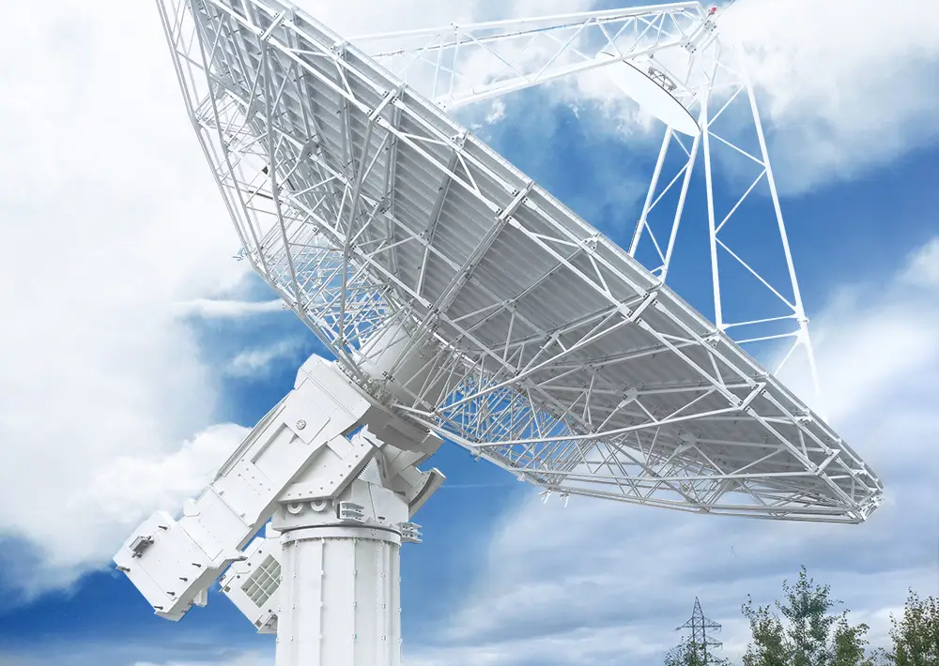
MOBILE AND WIRELESS COMMUNICATION
WAMEMA JOSHUA DICKSON 23/U/ETD/1564/GV
KISIGE DERRICK 22/U/ETD/0953/GV
OPIO COLLIN GIDEON 22/U/ETD/1106/GV
SSEMUJJU SHARIF ABDUKARIM 18/U/ETD/181/GV

Slide 2
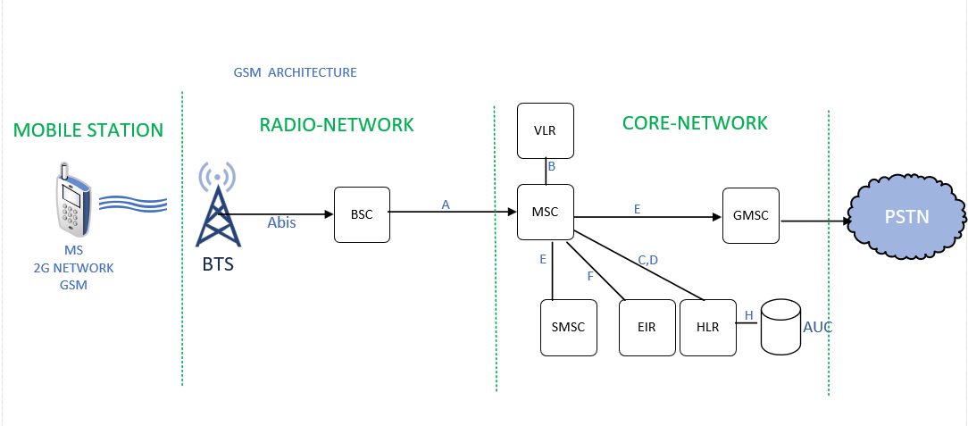
GSM ARCHITECTURE
NO. 4a
GSM Network Architecture Components
Mobile Station (MS):
User’s mobile device + SIM
Communicates via air interface
Identifies subscriber with IMSI
Base Station Subsystem (BSS):
Base Transceiver Station (BTS): Manages radio communication with MS
Base Station Controller (BSC): Controls multiple BTSs, manages handovers & resources
Network Subsystem (NSS):
Core network for call routing and switching
Interfaces with mobile and fixed networks

Slide 3
Functions of Each Network Component in GSM Network
NO. 4a
Mobile Station (MS): The user’s mobile device and SIM that communicates with the network via radio signals.
Base Transceiver Station (BTS): Facilitates wireless communication between the mobile station and the network within a cell.
Base Station Controller (BSC): Controls multiple BTSs, manages radio resources, handovers, and signaling to the MSC.
Mobile Switching Center (MSC): Handles call routing, switching, and mobility management in the GSM core network.
Home Location Register (HLR): Stores permanent subscriber data and current location information.
Equipment Identity Register (EIR): Maintains a database of valid and invalid mobile equipment identities.
Short Message Service Center (SMSC): Manages storing, forwarding, and delivery of SMS messages.
Gateway Mobile Switching Center (GMSC): Routes incoming calls from external networks to the subscriber’s MSC.
Visitor Location Register (VLR): Temporarily holds subscriber information for roaming users in an MSC area.
Authentication Center (AUC): Provides authentication and encryption keys to secure subscriber identity and communication.

Slide 4
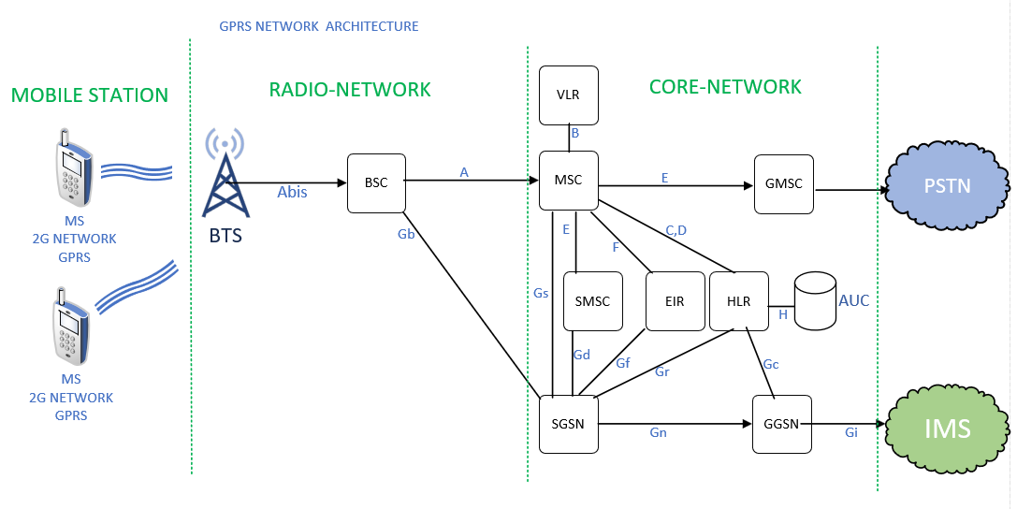
GPRS ARCHITECTURE
NO. 4b
Definition
GPRS (General Packet Radio Service) is a mobile data service that improves the GSM network to send and receive data like internet, email, and messages. Instead of dedicating a channel for each user, it sends data in small packets, making better use of the network. GPRS gives an “always-on” connection so users can stay connected without interruptions. It is called a 2.5G technology because it updates 2G networks while getting closer to the speed of 3G. GPRS adds new parts to the GSM network to handle packet data alongside regular voice calls.

Slide 5
GPRS Vs GSM
NO. 4b
GPRS Network Elements Added
Serving GPRS Support Node (SGSN): Functions like MSC but for packet data; tracks mobile devices, manages mobility, and routes packets within the GPRS network.
Gateway GPRS Support Node (GGSN): Connects GPRS to external data networks (the Internet) and routes data between mobile users and these networks.
Packet Control Unit (PCU): Located within the BSC, manages packet data transfer between the Mobile Station and SGSN over the radio interface.
Changes to GSM Network for GPRS & Functionality
BSC includes PCU for managing packet data transmission over radio channels.
Packet-switched domain overlays existing GSM circuit-switched network, enabling simultaneous voice and data.
MSC manages circuit-switched voice, SGSN manages packet-switched data.
HLR is updated for GPRS subscriber info; new interfaces added between BSC-SGSN and SGSN-GGSN.
GPRS enables “always-on” data, higher data rates, and billing based on data volume instead of connection time.

